Slide 1

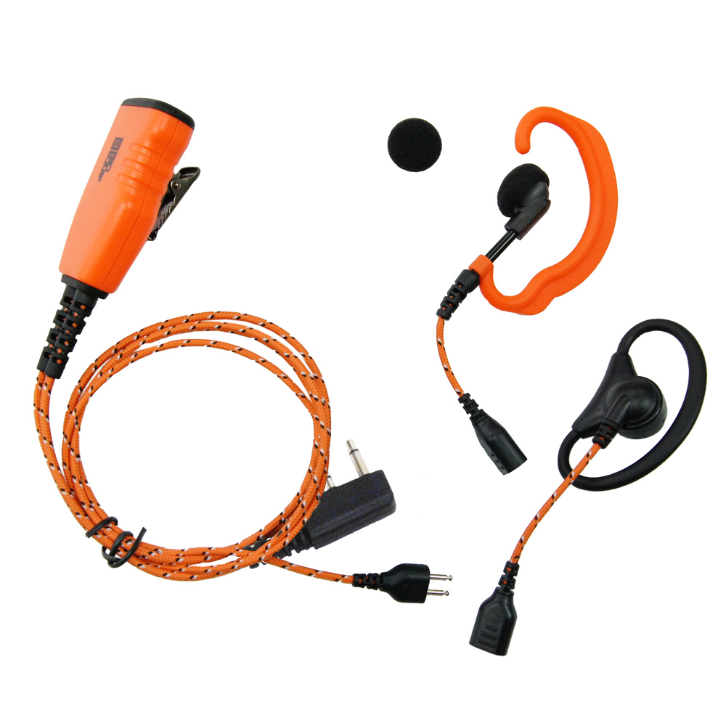
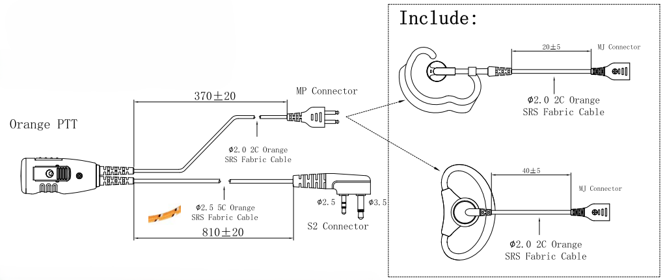



ProEquip PRO-U610L
headset 3-in-1 solution with icom L-connector
A ProEquip combination headset for Icom with orange FabricLine cables. It can be used with either the included C-shell or D-shell earpice or used with the Peltor SportTac, Tactical XP or other versions with the J22 connector.
There is also a range of other earpice solutions where the user can select their prefered earpiece/headset.
FEATURES & BENEFITS
Robust PTT with a secure clip
Hi quality microphone
Includes a C-shell earpice
Includes a D-shell earpice
Can be used with Peltor hearing protection headset with J22 input like SportTac or Tactical XP
For use with Peltor hearing protection headsets with 3.5mm audio input jack like ProTac III the adapter 64334 can be used
Orange FabricLine cables that do not tangle and have high strength
.
OPTIONAL Earpieces
29267 | ProEquip Acoustic Airtube
29342 | ProEquip Acoustic Airtube
30197 | ProEquip PRO-BS5 Headset
64334 | ProEquip Adapter 3.5mm/male
64336 | ProEquip PRO-U600 C-Shell
64337 | ProEquip PRO-U600 D-Shell
64384 | ProEquip Adapter 3.5mm/female
64389 | ProEquip Adapter Soundscope 3-pin
29431 | ProEquip Clip
MODEL PART.NO
ProEquip PRO-U610L 29115
headset 3-in-1 solution with icom
L-connector
Scan QR-Code to order online
SPECIFICATION
Cable length from connector to mic/PTT 81cm
Cable length from mic/PTT to earpiece connector 37cm

